Slide 1
Self-Organized Criticality in spatial evolutionary game simulation
By:
Rita Philavanh Jennifer Cheung
Brendan Fahy Brent Runyan
Daniel Lyons Michael Boone
Math 636 Final Project
Fall 2008

Slide 2
Outline
Background: Self-organized criticality (SOC)‏
History
Definition
Power Law
Examples
Model: Prisoner's dilemma simulated
on a cellular automaton
Technical Aspects
In Context of SOC
  Data Fitting: Analysis of data
  Power Law Fit
  System I: Plots and Analysis
  System II: Plots and Analysis
  Conclusion
  Our Findings
  Future Work
  END

Slide 3
Self-Organized Criticality:
Theoretical Background

Slide 4
History
  Background: SOC
  History
  Definition
  Power Law
Bak, Tang, and Wiesefeld. 'Self-Organized Criticality: An Explanation of 1/f Noise.' Physical Review Letters. (1987).
Were interested in understanding where 1/f noise came from
1/f noise observed mainly in large open systems with many degrees of freedom
It appears in seemingly different systems, so it can't be sensitive to the particular details of the system
That is, the important features of the behavior are universal within that class of dynamical system

Slide 5
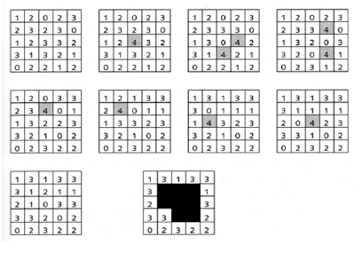
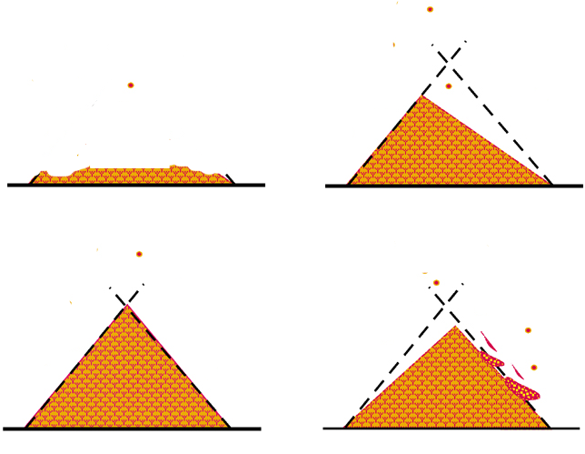
History
  Background: SOC
  History
  Definition
  Power Law
Classic Sand Pile Example

Slide 6
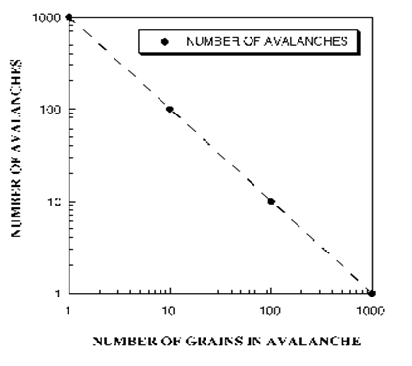
History
  Background: SOC
  History
  Definition
  Power Law
The power law is a simple model that can describe complex systems
that have an SOC state.
Example
  The power law distribution is a necessary condition for a system to display
  SOC, but is not sufficient. There are other factors.

Slide 7
Characteristics
  Background: SOC
  History
  Definition
  Power Law
Generalization of the necessary elements for a system to display SOC:
A complex system with many interacting components governed
by simple rules.
A slow driving force (stress) acting upon on the system.
Intermittent avalanches (event) occurring that causes a domino
effect throughout the system.
A critical point as an attractor.

Slide 8
Definition
  Background: SOC
  History
  Definition
  Power Law
SOC is a structure of states in complex systems, evolved through time and space
to self-organizes into many minimally stable states, until it gradually reaches
its critical scale-invariant state.
Self-organizing
      The system can evolve to this state free from initial sensitivity and
      without fine setting of the parameter value.
      There is no external organizing force. The internal interactions
      organize the system into the critical state, not the slow driving force.
    Critical
      It maintains a minimally stable form until a critical threshold is reached,
      and then it shows a transient phenomena – avalanches.
      Avalanches occur where local perturbations propagate throughout the system.
      The statistical nature of the avalanches during the transient stage
      of the system has a power law distribution, which gives it the scale
      invariant behavior (no characteristic event size exists).

Slide 9
Power Law
  Background: SOC
  Definition
  Power Law
  Examples
Before criticality is reached, the effect of perturbation on a localized region of the system will be localized.
When criticality is reached, the effect of perturbation on a localized
region gets distributed throughout the system.
    - Components that span the system are percolating through the system. This allows a connected path for localized perturbation to travel across the system and create a larger effect.
The probability that an event of size s will occur is given by:
P(s) ~ s^-a
  The defining factor to model SOC is the power law distribution

Slide 10
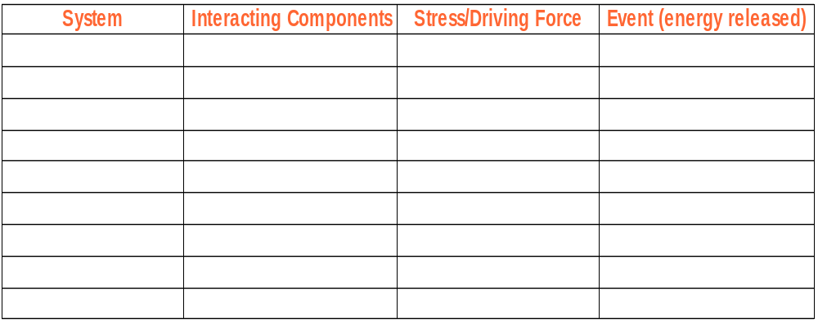
Examples
  Background: SOC
  Power Law
  Examples
  Model: PD simulation

Slide 11
Spatial evolutionary game model:
Prisoner's dilemma simulated on a lattice

Slide 12
  Model: PD simulation
  Technical Aspects
  In context of SOC
  Data Fitting
Prisoner’s Dilemma
(a.k.a. Screw Your Neighbor)‏
cooperate
defect
Reward for mutual cooperation
Sucker’s payoff
cooperate
Reward for mutual cooperation
defect
Temptation to defect
Punishment for mutual defection
T > R > P > S
It is always better to Defect,
regardless of the other player’s strategy
Mutual Defection is the rational outcome
Both players better off with mutual Cooperation

Slide 13
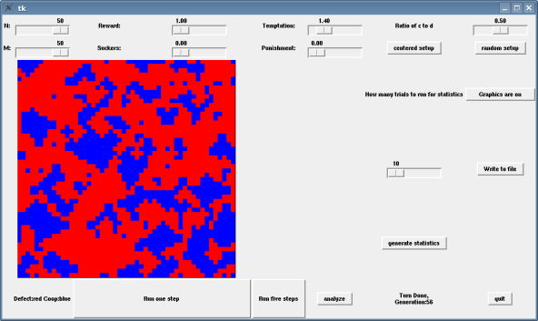
  Model: PD simulation
  Technical Aspects
  In context of SOC
  Data Fitting
SPD Simulation

Slide 14
  Model: PD simulation
  Technical Aspects
  In context of SOC
  Data Fitting
Properties of our simulation
  Continuous at boundaries. Played on a torus
  Adjustable payoff matrix and scale
  Random initial conditions
  No mixed strategies
  von Neumann neighborhood without self interaction

Slide 15
  Model: PD simulation
  Technical Aspects
  In context of SOC
  Data Fitting
Simulate!
For simplicity fixed three of the parameters (R=1, S=P=0) so that it is just a system of one variable.
Found that there are four different regions with unique dynamics.
The first region stabilizes mostly cooperators.
The second appears chaotic
The third is cyclic.
Quantitative Output
Ratio of cooperators to defectors after each generation.
The number of clusters and frequency count of clusters by size.

Slide 16
  Model: PD simulation
  Technical Aspects
  In Context of SOC
  Data Fitting
So what is interesting about this system?
What does this have to do with SOC?

Slide 17
  Model: PD simulation
  Technical Aspects
  In Context of SOC
  Data Fitting
Reasons we chose this system
Similarities to the classic example of SOC given by sand pile model on a grid.
Displays properties of self organization. Stable configurations develop.
Interesting patterns of clusters and chaotic growth

Slide 18
Data Fitting:
Analysis of data generated from PD simulation

Slide 19
  Data Fitting
  Power Law Fit
  System I
  System I: Plots
Power Law fit
Prevailing characteristic of SOC is a power law
1. f(x) = Cx^-α
2. Scale invariance

Slide 20
  Data Fitting
  Power Law Fit
  System I
  System I: Plots
Power Law fit
f(x) = Cx^-α
Logf(x) = -αlogx + logC where this is a linear relation with slope = -α and y intercept of logC

Slide 21
SYSTEM I PARAMETERS
  Data Fitting
  Power Law Fit
  System I
  System I: Plots
T > R > P > S
T = 1.3, R = 1.1, P = 0.4, S = 0
2R > S + T

Slide 22
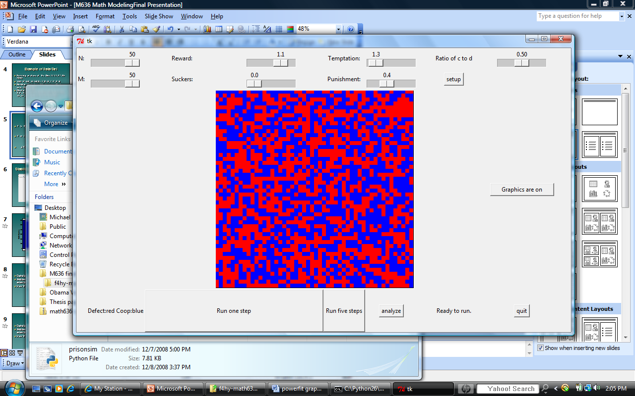
  Data Fitting
  Power Law Fit
  System I
  System I: Plots
Starting 1:1 ratio of C:D

Slide 23
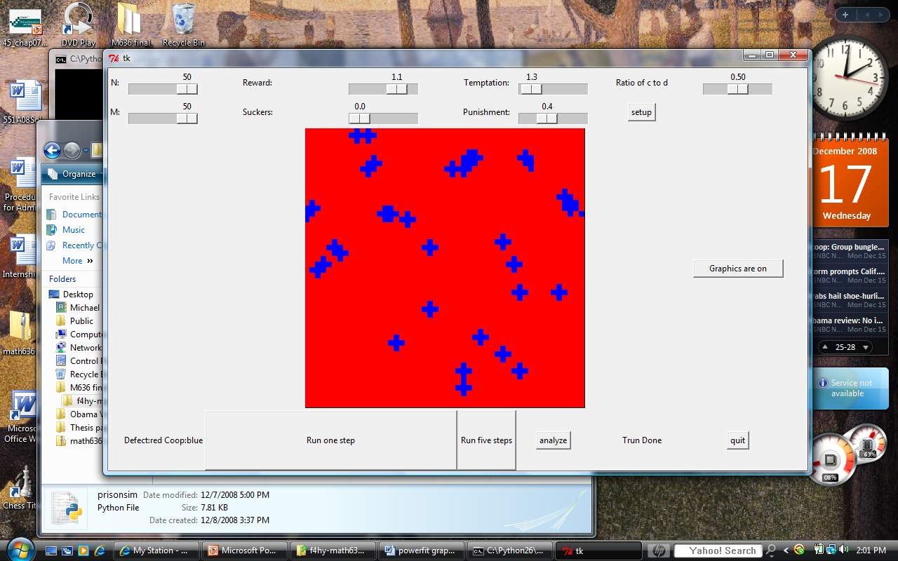
Stabilizes quickly <10 iterations
  Data Fitting
  Power Law Fit
  System I
  System I: Plots

Slide 24
  Data Fitting
  Power Law Fit
  System I
  System I: Plots
Example of Data Set
Running analysis at Thu Dec 11 11:27:35 2008
With M=50, N=50,R=1,S=0,T=2,P=0
Number of clusters: 32, Average Cluster size: 10.906250
Cluster sizes: [5, 5, 5, 5, 5, 5, 5, 5, 5, 5, 8, 8, 8, 8, 8, 8, 8, 10, 10, 10, 10, 11, 12, 12, 14, 16, 18, 18, 18, 24, 26, 34]

Slide 25
  Data Fitting
  Power Law Fit
  System I
  System I: Plots
MATLAB
Histogram to look at data distribution
Log( [ cluster_size, cluster_freq])‏
Plots this data
Best fit linear regression line thru data ( α determination)‏
SSE calculation

Slide 26

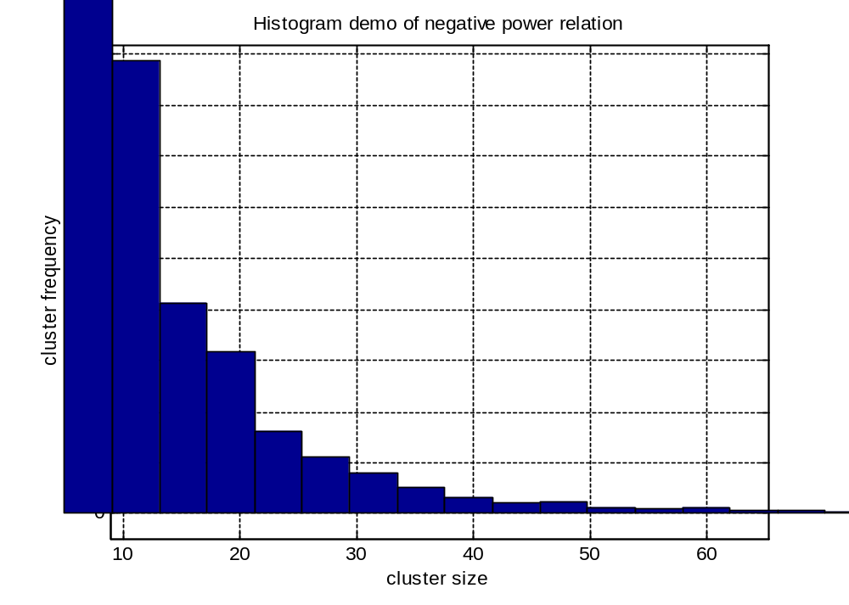
  Data Fitting
  System I
  System I: Plots
  System I: Analysis
Distribution of Data

Slide 27
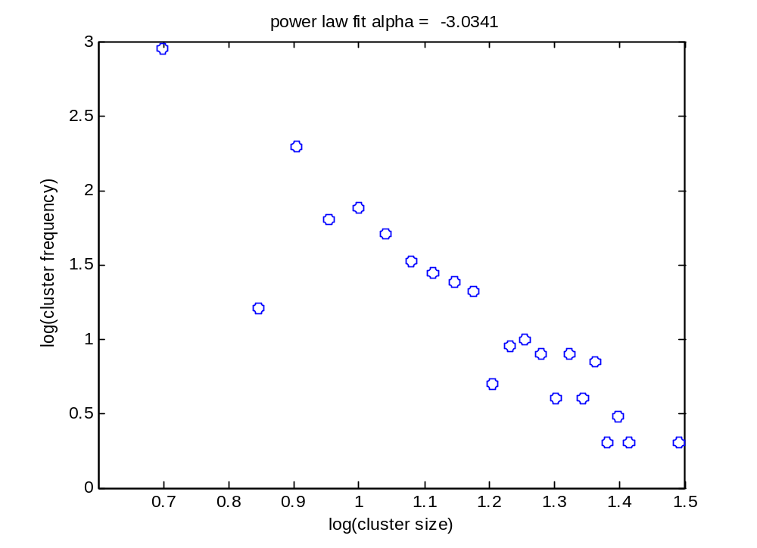
  Data Fitting
  System I
  System I: Plots
  System I: Analysis
400 x 400 Lattice

Slide 28
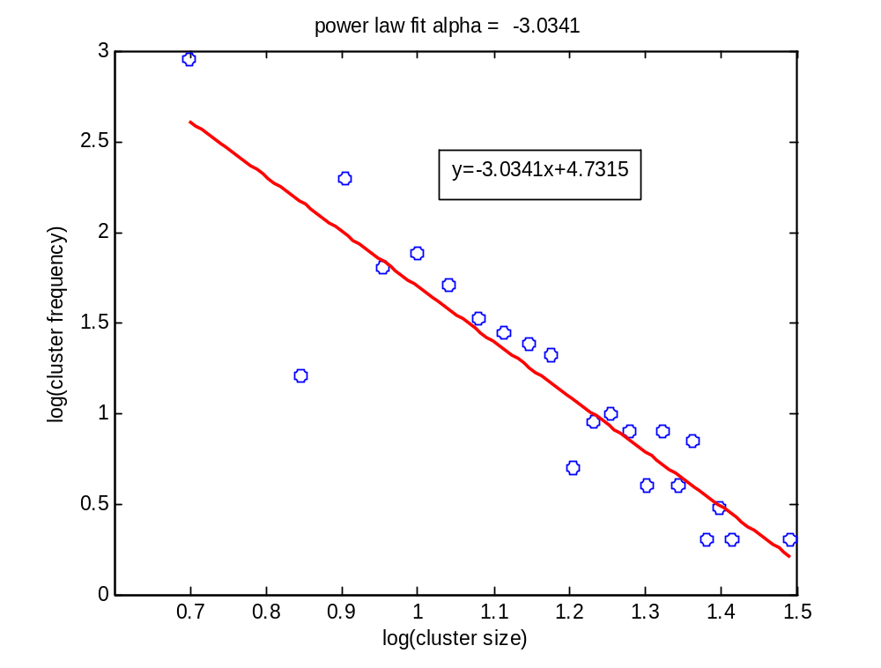
  Data Fitting
  System I
  System I: Plots
  System I: Analysis
400 x 400 Lattice

Slide 29
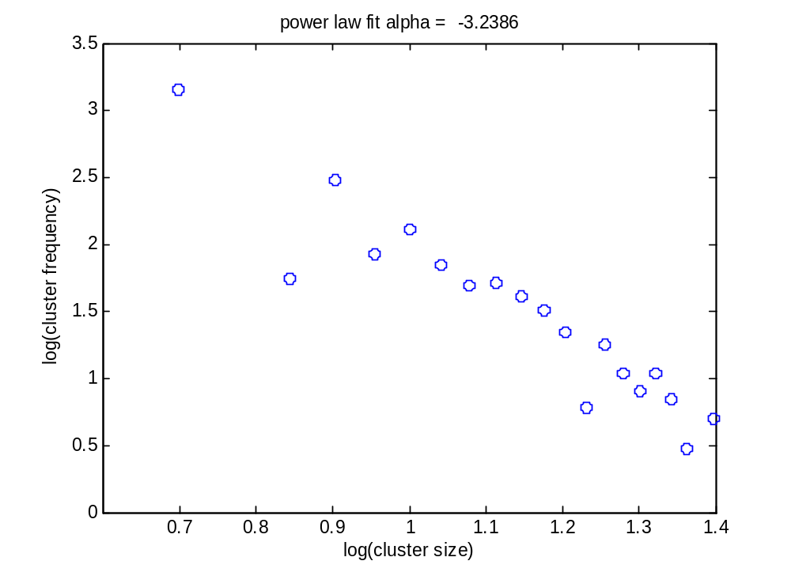
  Data Fitting
  System I
  System I: Plots
  System I: Analysis
500 x 500 Lattice

Slide 30
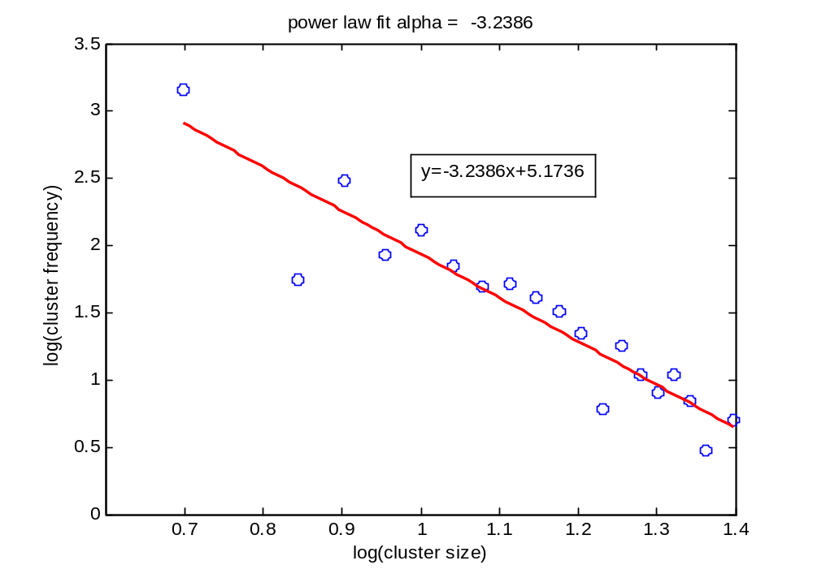
  Data Fitting
  System I
  System I: Plots
  System I: Analysis
500 x 500 Lattice

Slide 31
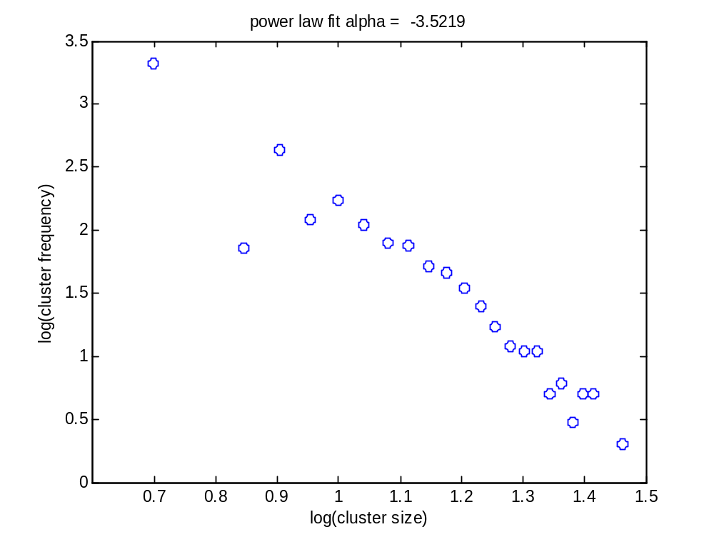
  Data Fitting
  System I
  System I: Plots
  System I: Analysis
600 x 600 Lattice

Slide 32
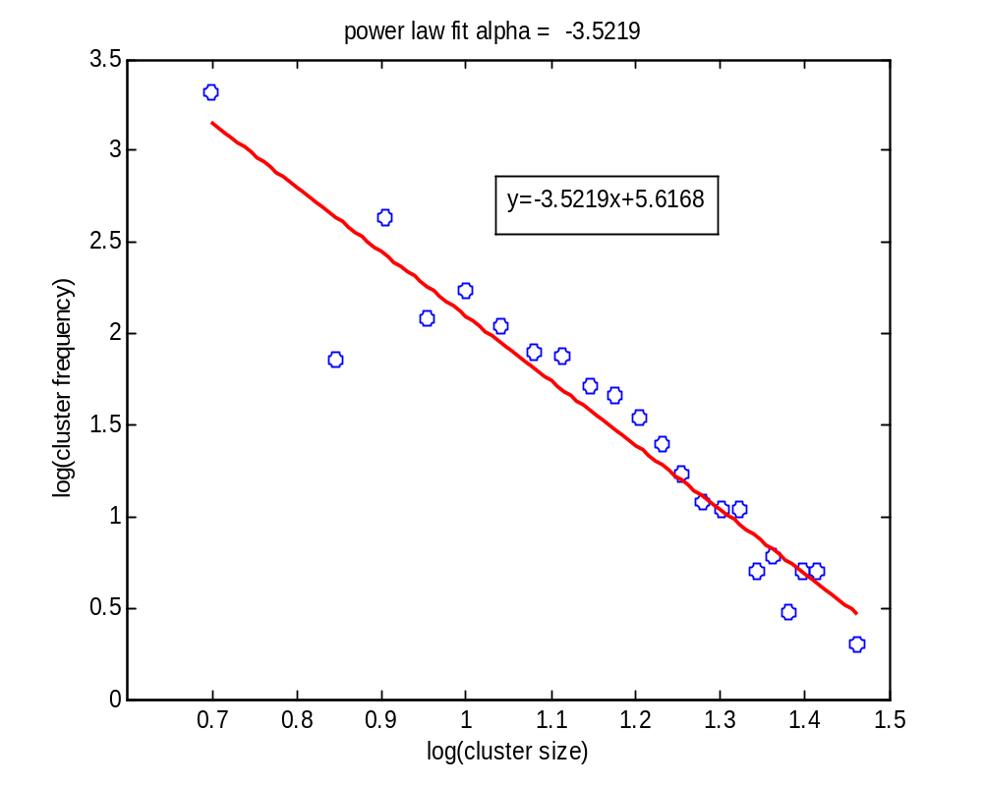
  Data Fitting
  System I
  System I: Plots
  System I: Analysis
600 x 600 Lattice

Slide 33
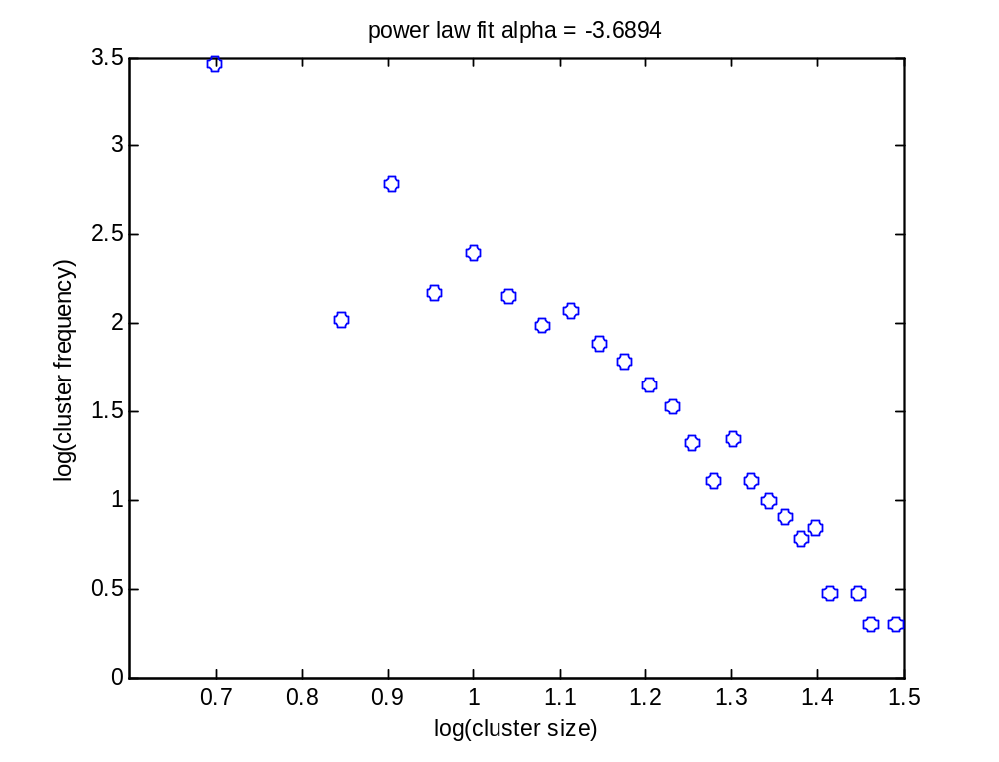
  Data Fitting
  System I
  System I: Plots
  System I: Analysis
700 x 700 Lattice

Slide 34
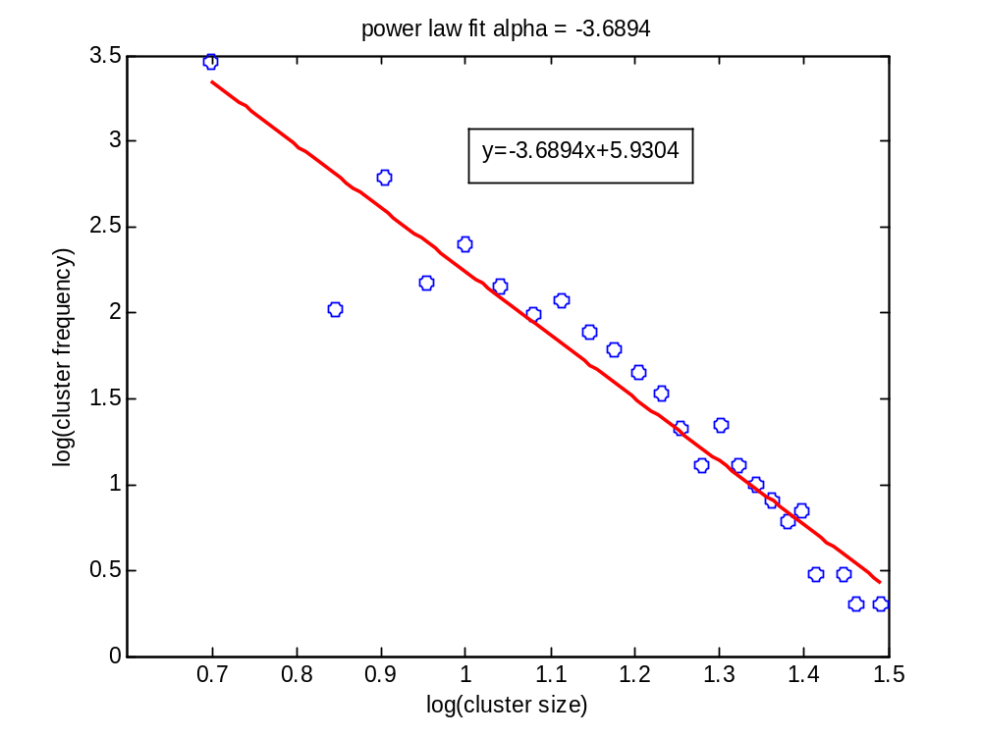
  Data Fitting
  System I
  System I: Plots
  System I: Analysis
700 x 700 Lattice

Slide 35
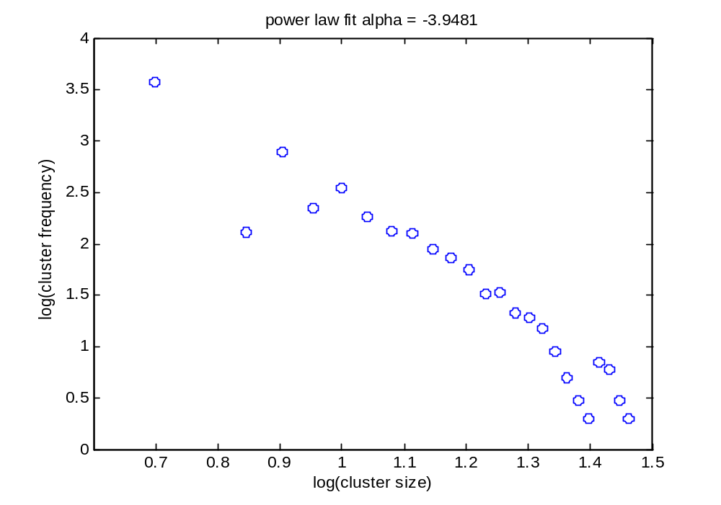
  Data Fitting
  System I
  System I: Plots
  System I: Analysis
800 x 800 Lattice

Slide 36
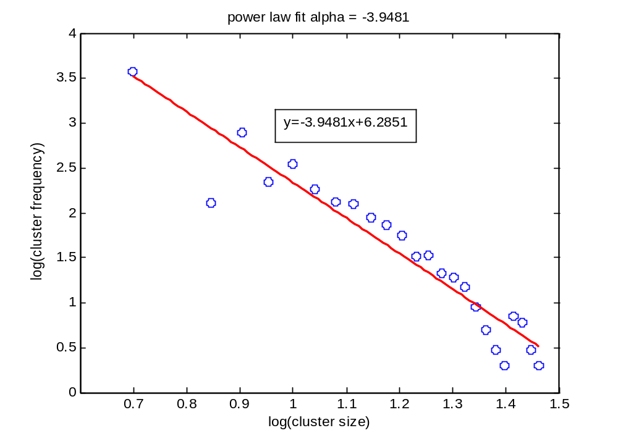
  Data Fitting
  System I
  System I: Plots
  System I: Analysis
800 x 800 Lattice

Slide 37
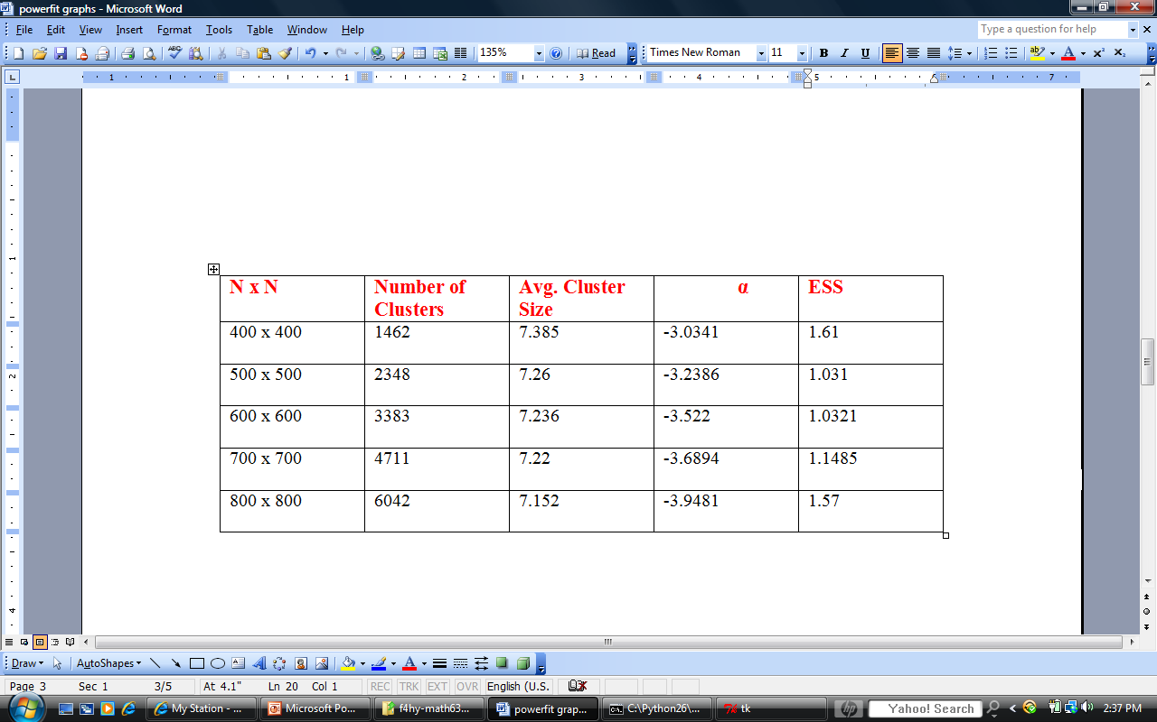
  Data Fitting
  System I: Plots
  System I: Analysis
  System II
Summary of Data

Slide 38
  Data Fitting
  System I: Plots
  System I: Analysis
  System II
System I Analysis
For Increasing lattice size:
α decreases monotonically-does not stabilize.
Sum Squared Error seems to stabilize.
Possibly exhibits power law behavior.

Slide 39
  Data Fitting
  System I: Analysis
  System II
  System II: Plots
SYSTEM II
T=1.4, R=1, P=S=0
Does not fit strictly the inequality of the Prisoner’s Dilemma
However, interesting “chaotic” behavior

Slide 40
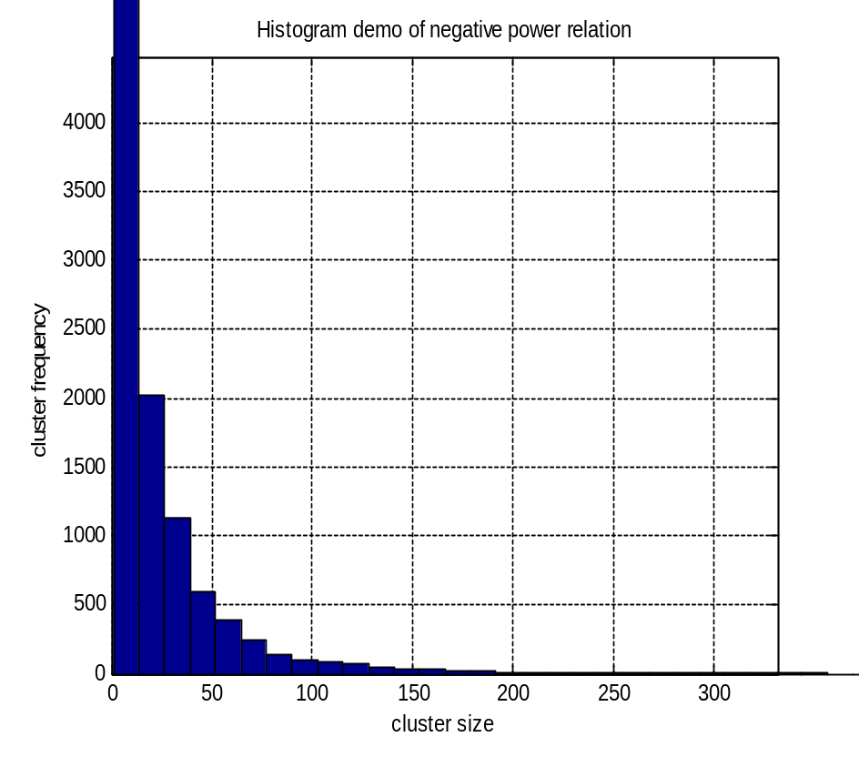
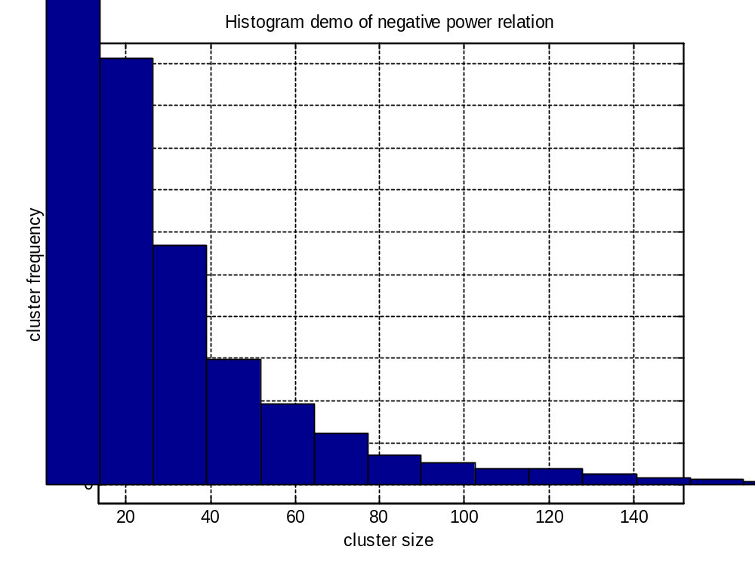
Histogram distribution of data
  Data Fitting
  System II
  System II: Plots
  System II: Analysis

Slide 41
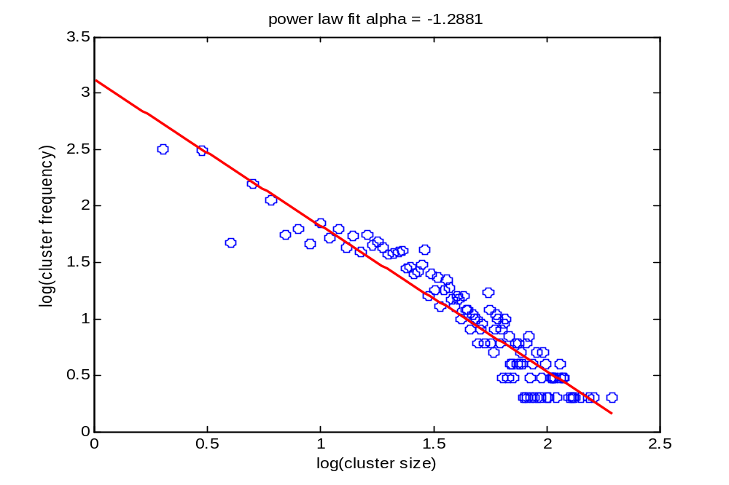
  Data Fitting
  System II
  System II: Plots
  System II: Analysis
400 x 400

Slide 42
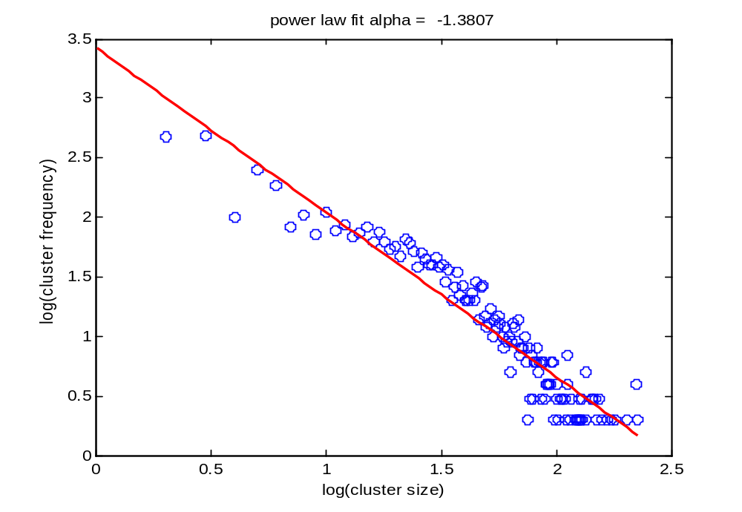
  Data Fitting
  System II
  System II: Plots
  System II: Analysis
500 x 500

Slide 43
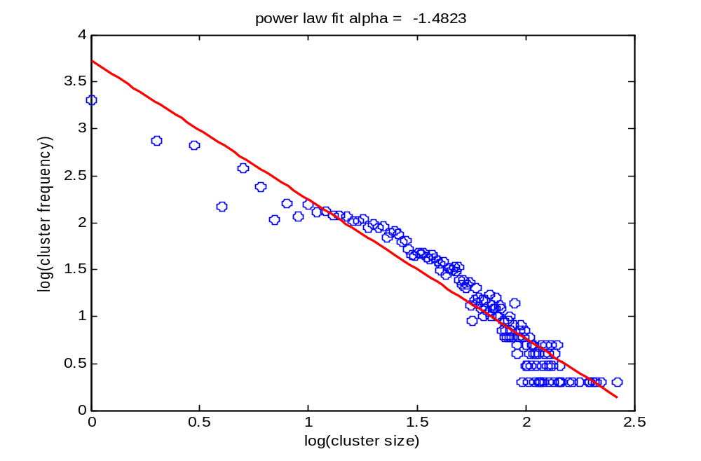
  Data Fitting
  System II
  System II: Plots
  System II: Analysis
600 x 600

Slide 44
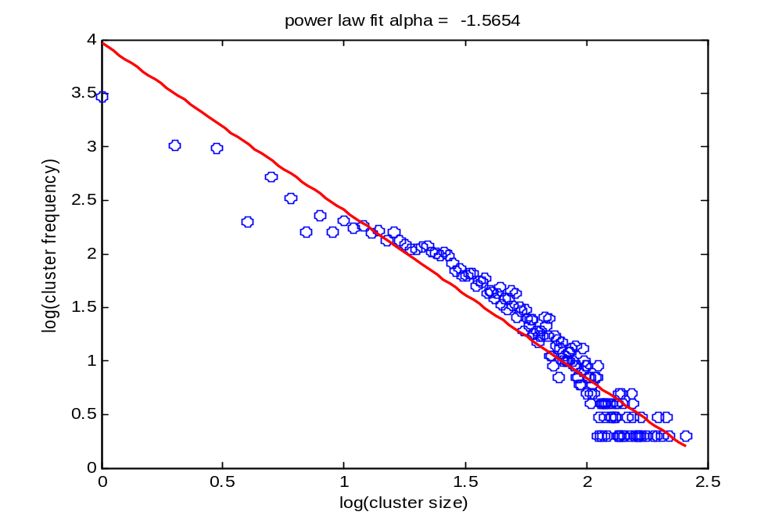
  Data Fitting
  System II
  System II: Plots
  System II: Analysis
700 x 700

Slide 45
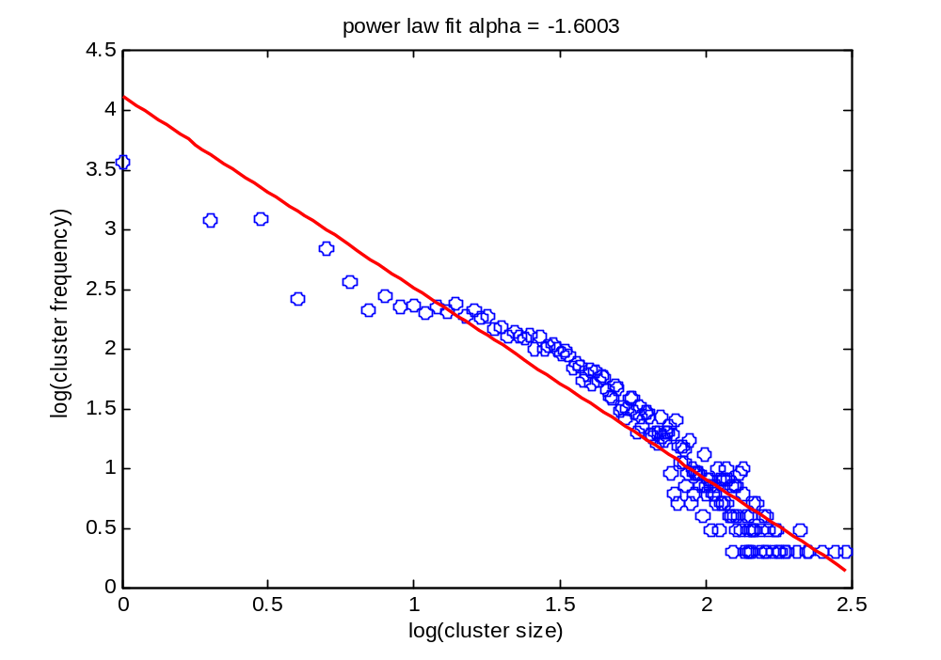
  Data Fitting
  System II
  System II: Plots
  System II: Analysis
800 x 800

Slide 46
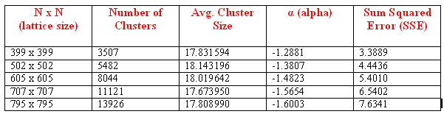
  Data Fitting
  System II: Plots
  System II: Analysis
  ?????
Summary of Data

Slide 47
  Data Fitting
  System II: Plots
  System II: Analysis
  Conclusion
System II Data Analysis
For Increasing lattice size:
α decreases monotonically but possibly converges to some value.
Sum Squared Error increases monotonically.
Does not exhibit power law.

Slide 48
Conclusion

Slide 49
Our Findings
  Conclusion
  Our Findings
  Future Work
  END
So does our simulation exhibit properties of a self organized criticality?

Slide 50
  Conclusion
  Our Findings
  Future Work
  END
Well.. no.
There is no configuration where avalanches are present.
Depending on the parameters the system either remains chaotic or reaches a final stable state. Perturbations in the stable states do not create avalanches and return to the unperturbed state in the next step.
While many aspects of the system do exhibit scale invariance this does not imply SOC.

Slide 51
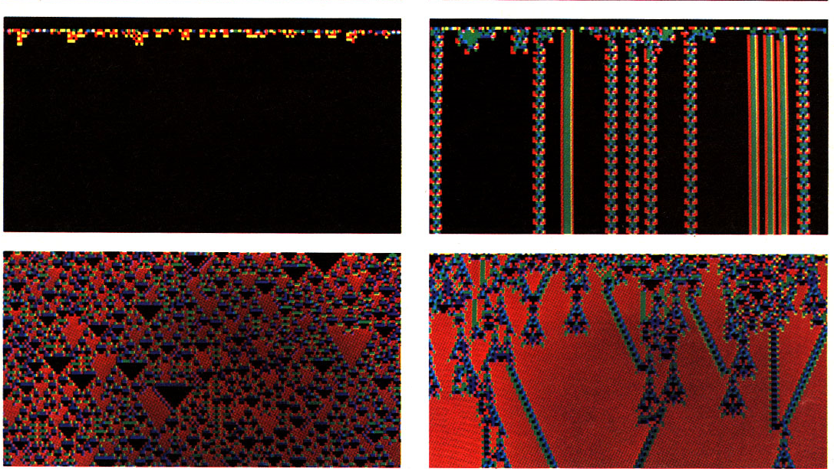
  Conclusion
  Our Findings
  Future Work
  END
Wolfram’s CA Classes
Class I: homogeneous
Class II:
simple or periodic
Class III:
Chaotic
Class IV:
Complex global structures

Slide 52
  Conclusion
  Our Findings
  Future Work
  END
The Spatial Hawk-Dove Game
dove
hawk
1
0
dove
2
1-β
hawk
T > R > S > P β in (1,infty)‏
Both players better off with mutual dove
Not always better to be a Haw

Slide 53
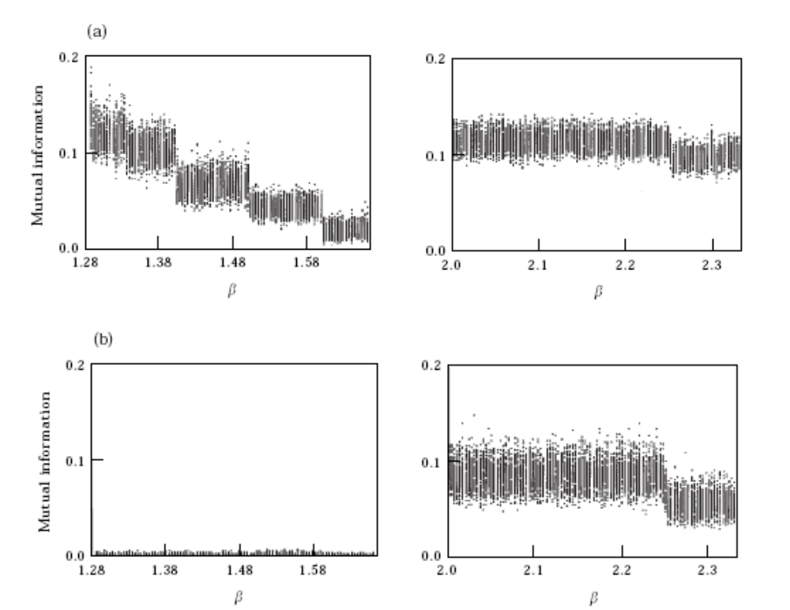
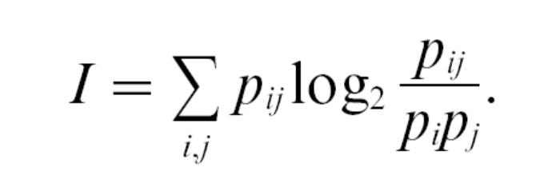
  Conclusion
  Our Findings
  Future Work
  END
The Spatial Hawk-Dove Game
Chaos
β in (9/7,5/3)‏
Criticality
β in (2,7/3)‏
Mutual Information

Slide 54
  Conclusion
  Future Work
  END
THE END
and
Happy Holidays!

